Slide 1
MY FINANCE BUDDY
Mukund Salia
Satbir Saini
Shu Zhang
Robina Bhatia

Slide 2
Functional Properties
A quick and easy to use application that manages your finances!
Set a financial goal and save money to achieve that goal with the help of My Finance Buddy!
Collaborate with your friends and save more for a set financial goal!

Slide 3
YouTube Video
https://www.youtube.com/watch?v=5yjiufpo9tY

Slide 4
Functional Properties
1. User registration and Login
2. Set, update, manage and delete a financial goal
3. Add a friend
4. Collaborate with friends towards goals
5. Change settings for the appearance of the Dashboard and privacy of the profile

Slide 5
Non Functional Properties
1. User friendly
2. Cost Benefit
3. Accuracy
4. Scalability

Slide 6
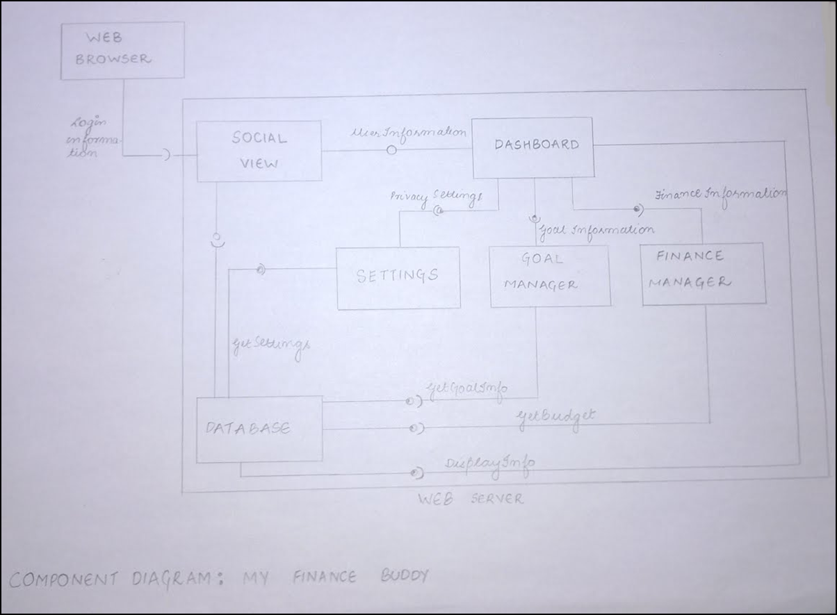
Client-Server Architecture

Slide 7
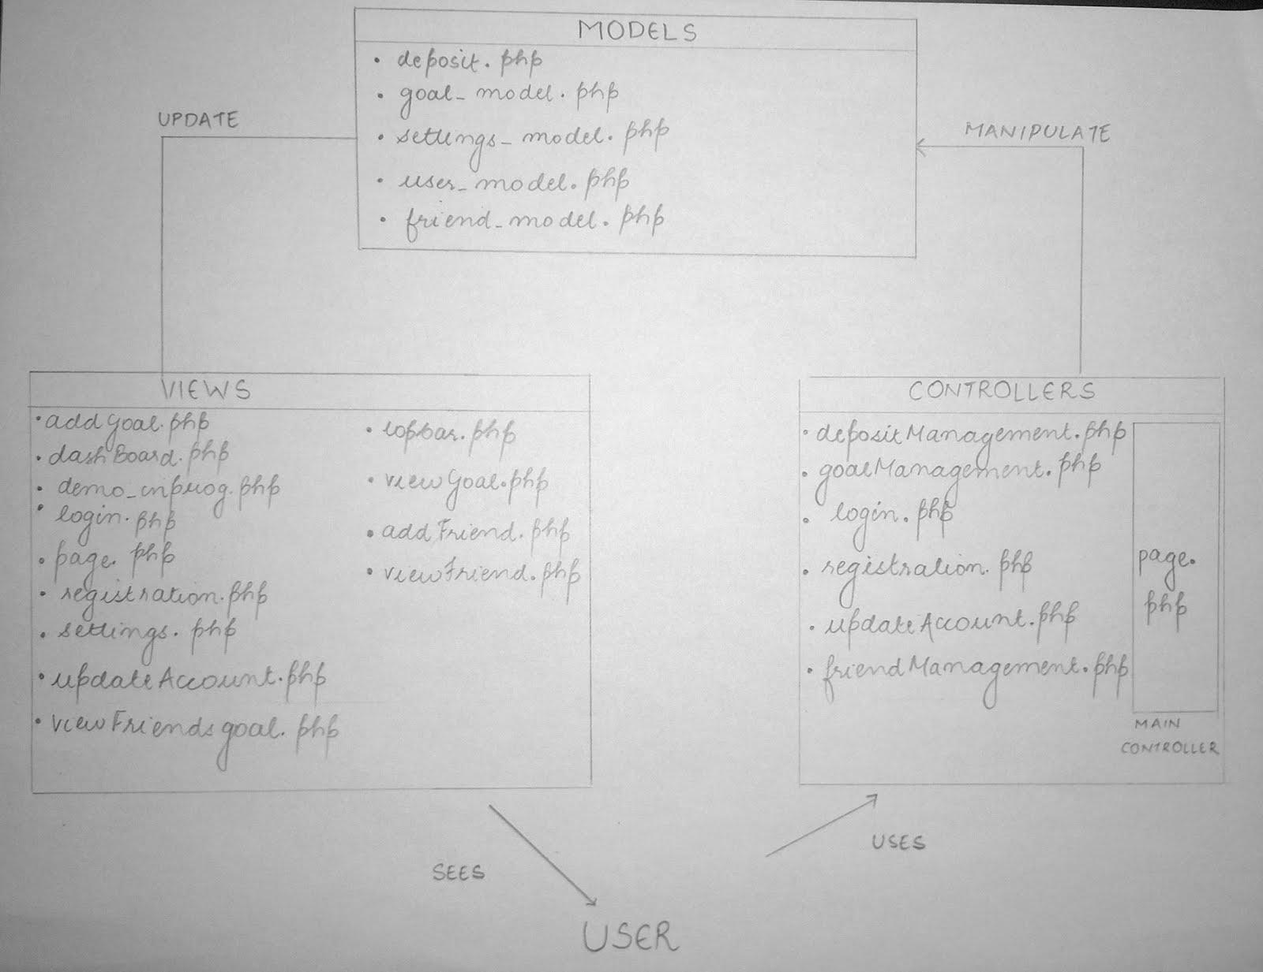
Model-View-Controller Architecture

Slide 8
Future
Many of the functional properties that were proposed have been reached. The difficulties faced were to be able to make the application accurate in terms of calculations including rate of interest and other accounts related factors.

